Slide 1

SQL Project
Music Store Data Analysis

Slide 2

About me
Hello Everyone, I’m Vamshi Marikanti,
I completed my B.Tech in Computer Science Engineering (2018–2021) with 70%.
Currently, I’m working as an Oracle Technical Consultant at ECS, with 3+ years of experience
🔗 LinkedIn: linkedin.com/in/vamshi-marikanti 💻 Website: vamc003.github.io/Portofolio

Slide 3
Objective
The objective of this project is to analyze the Music Store database using MySQL to extract meaningful business insights.
Through this analysis, we aim to:
Understand customer purchasing behavior and preferences.
Identify the most popular genres, artists, and tracks.
Evaluate sales performance across customers, countries, and employees.
Derive insights to improve marketing strategies and inventory management.
Demonstrate SQL skills in data extraction, aggregation, and reporting.

Slide 4
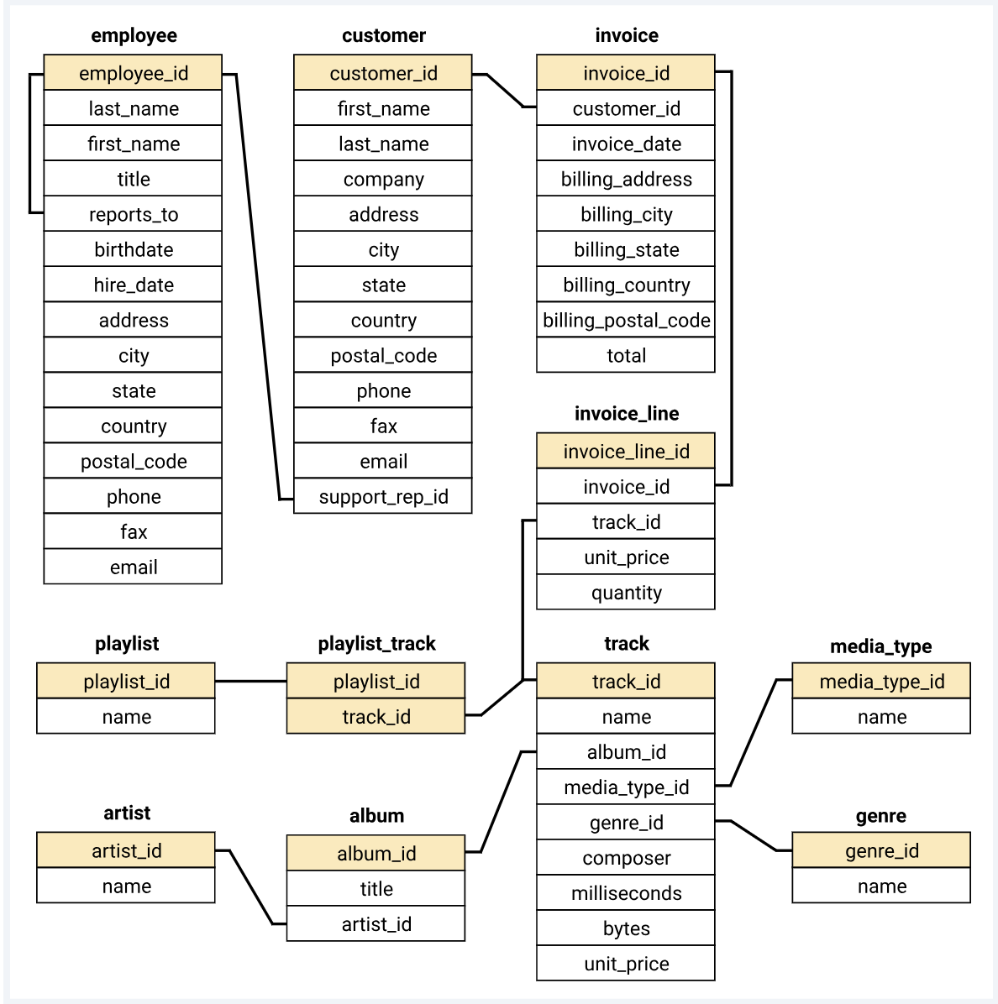
ER Diagram and schema explanation

Slide 5
Key analysis
Identify the senior-most employee based on job title to understand store hierarchy.
Analyze country-wise invoice distribution to find where most purchases occur.
Discover the top 3 highest invoice totals to understand big sales transactions.
Determine the best-performing city by total revenue to plan promotional events.
Identify the best customer — the one who spent the most money overall.
Analyze Rock music listeners by email and name to target them in marketing campaigns.

Slide 6
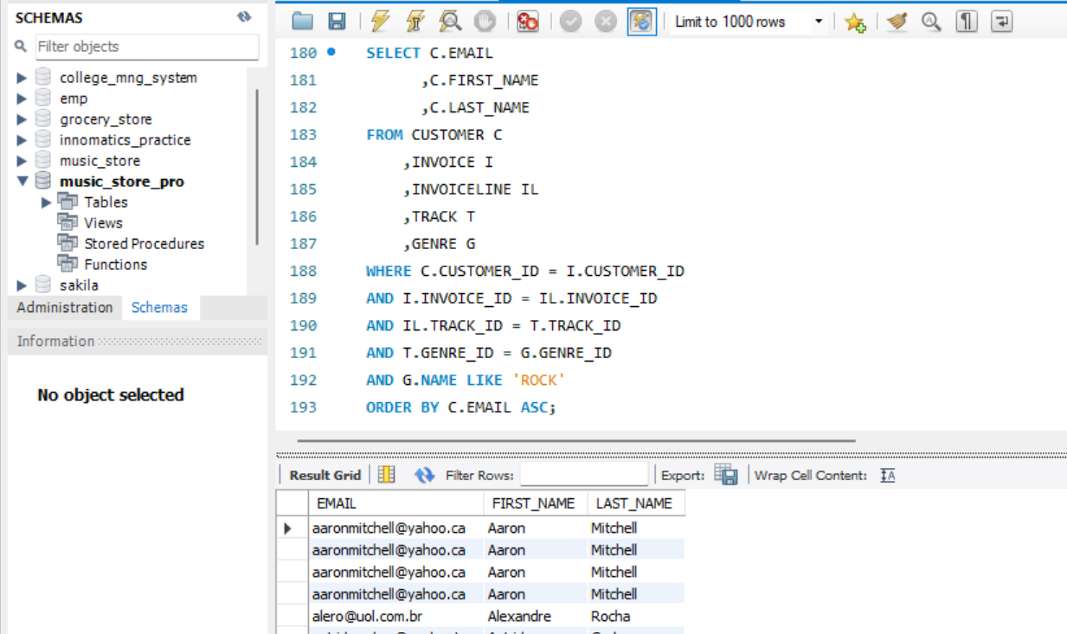
SQL query & results
6. Write a query to return the email, first name, last name, & Genre of all Rock Music listeners. Return your list ordered alphabetically by email starting with A

Slide 7
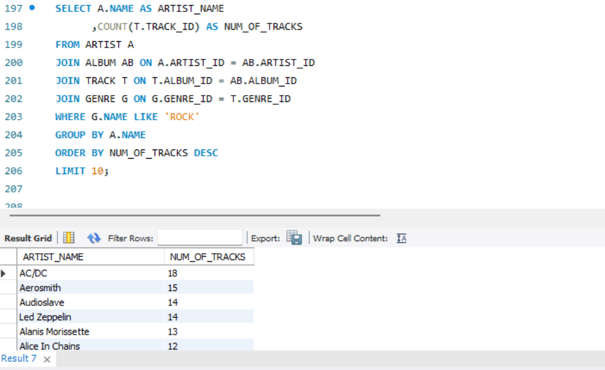
SQL query & results
7Q, Let's invite the artists who have written the most rock music in our dataset. Write a query that returns the Artist name and total track count of the top 10 rock bands

Slide 8
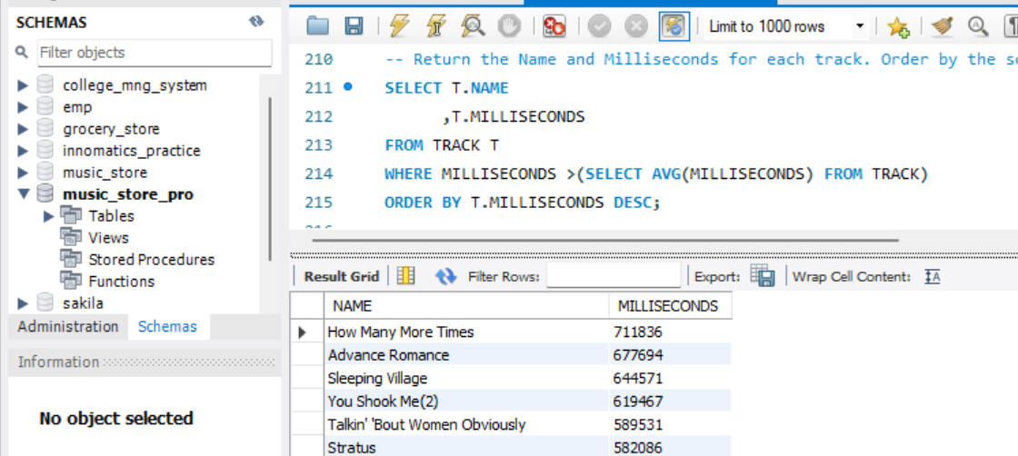
SQL query & results
8. Return all the track names that have a song length longer than the average song length. Return the Name and Milliseconds for each track. Order by the song length, with the longest songs listed first

Slide 9
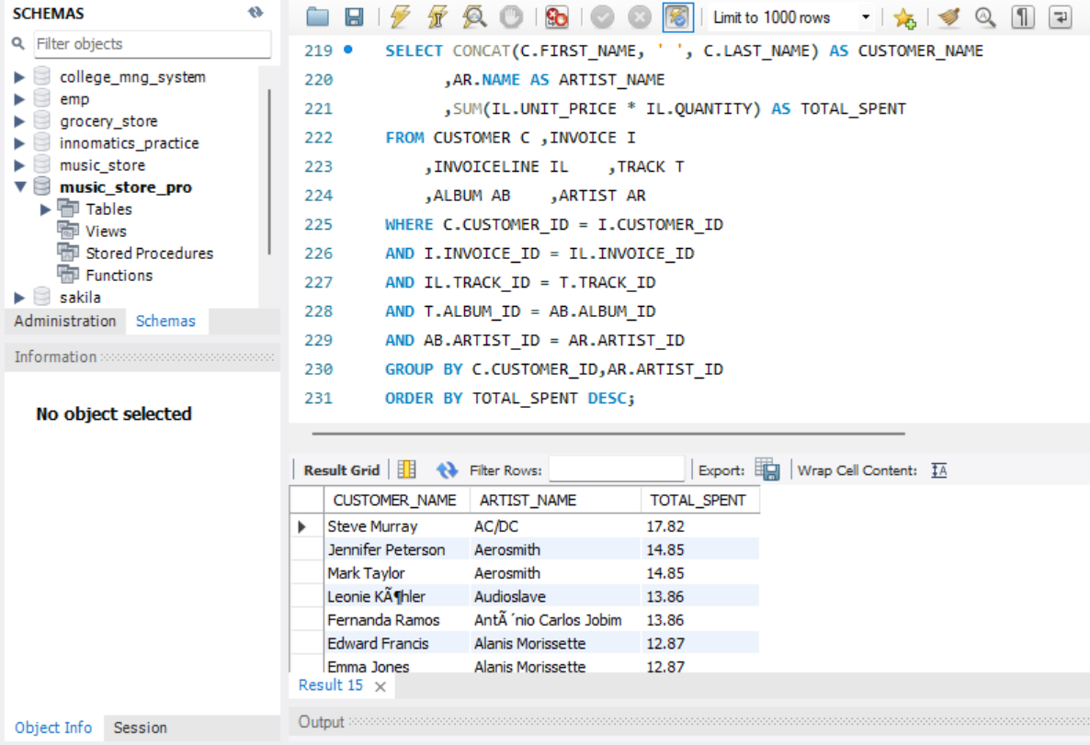
SQL query & results
Q9. Find how much amount is spent by each customer on artists? Write a query to return customer name, artist name and total spent

Slide 10
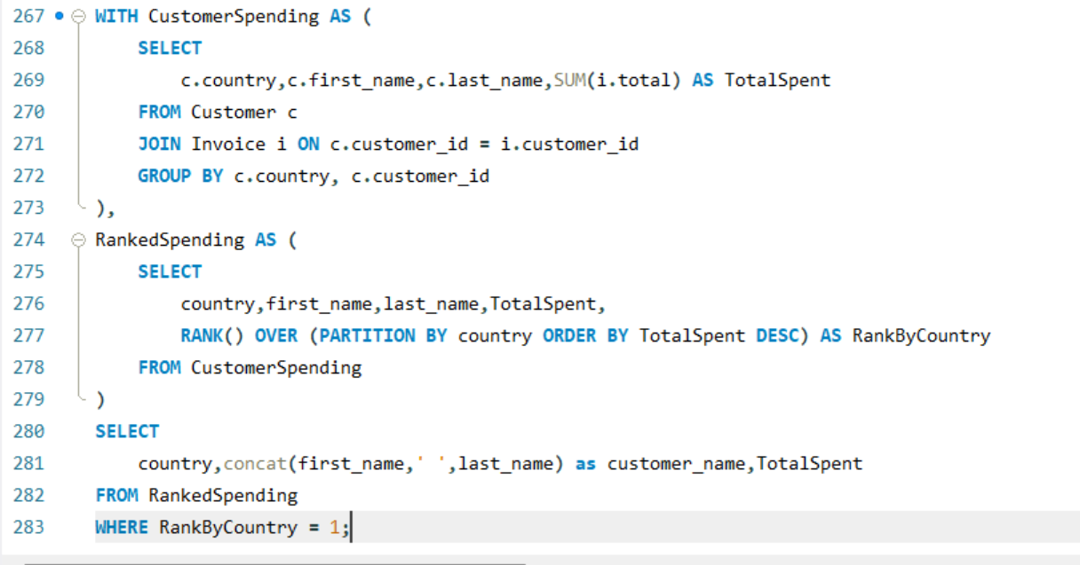
SQL query & results
Q11. Write a query that determines the customer that has spent the most on music for each country. Write a query that returns the country along with the top customer and how much they spent. For countries where the top amount spent is shared, provide all customers who spent this amount Top spending customer for each country

Slide 11
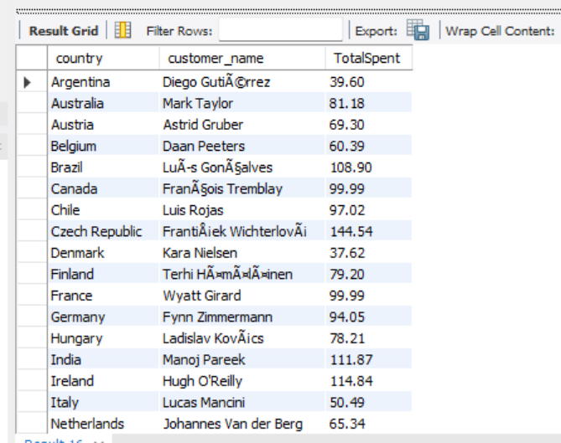
SQL query & results

Slide 12
Business insights & Recommendations
Top Customers: Identify and target high-spending customers with personalized promotions to increase loyalty.
Genre Popularity: Rock and Pop genres dominate sales—focus marketing and inventory on these genres.
City Performance: Cities with highest revenue (e.g., top 3 cities) are ideal for local events or festivals.
Artist Collaborations: Promote tracks from artists with the most purchases to boost engagement.
Customer Segmentation: Segment customers by spending to design tiered loyalty programs.

Slide 13
Experience/Challenges working on SQL – Data Analysis Project.
While loading the data, faced multiple issues with data inconsistency and missing values.
Designing efficient queries for complex aggregations across multiple tables was a learning curve.
Handling many-to-many relationships between customers, tracks, and artists required careful joins.
Ensuring accurate grouping and summing for financial metrics like total spent per customer.
Working with date fields for invoice analysis highlighted formatting and filtering challenges.

Slide 14
Conclusion
Successfully analyzed the Music Store dataset to derive key business insights.
Identified top customers, top genres, and top-performing artists for targeted marketing.
Determined city-wise and country-wise spending patterns to guide promotions and events.
Applied advanced SQL concepts like CTEs, window functions, and aggregations for meaningful analysis.

Slide 15
Q&A
Ready to answer any specific queries or clarifications

Slide 16

THANK
YOU

